Slide 1
Sensor Network using Arduino Fio
Nripun Sredar
Shaunak Vairagare
Sujeet Kuchibhotla

Slide 2
Components
Command Station
PC
Xbee Radio
Xbee Explorer Adapter
Sensor Station
Arduino Fio
Xbee radio
Temperature Sensor/ Moisture Sensor

Slide 3
Configure Xbee Radios

Slide 4
Wireless programming using Arduino IDE

Slide 5
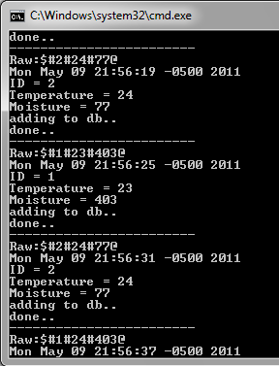
Wireless Serial Communication
Message Format
$#ID#temp#moist#batt@
Transmission Range
300 ft (line of sight)

Slide 6
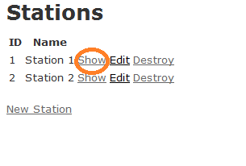
Data Logger UI

Slide 7
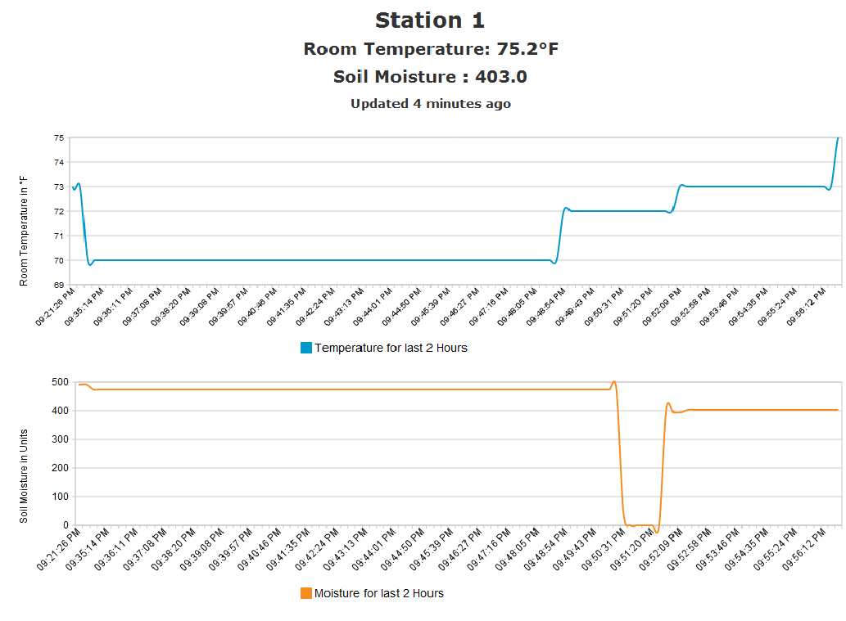
Data Logger UI

Slide 8
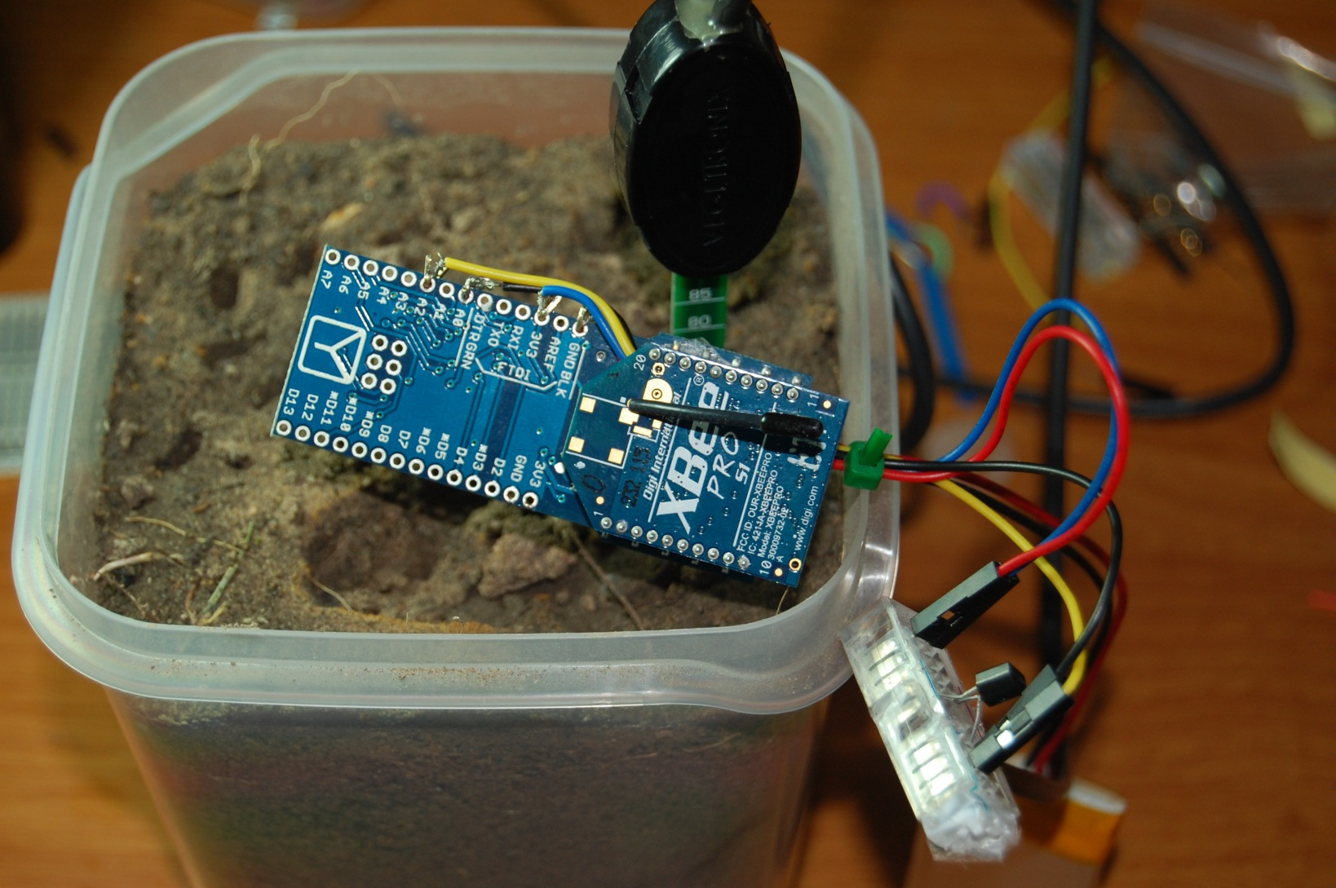
Some Project Pictures

Slide 9
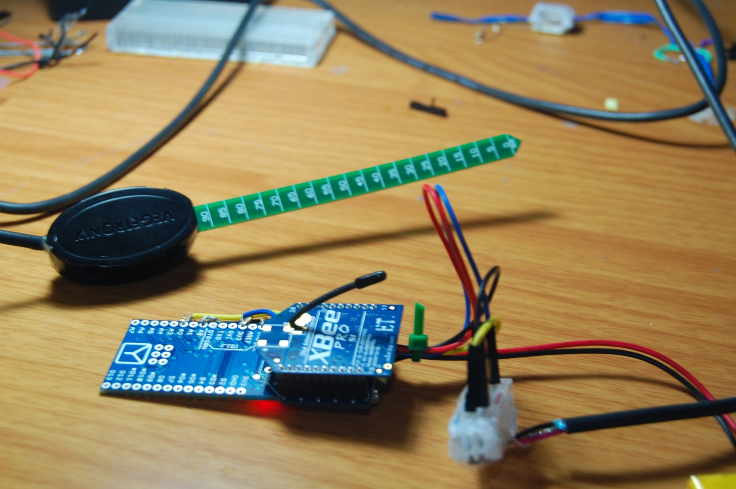
Some Project Pictures

Slide 10
Serial Client and Graph Visualization
Yogesh Kalaskar

Slide 11
Serial Client
Why do we need it?
XBee transmits the values to COM Port
The aim : To store values in database and generate graph

Slide 12
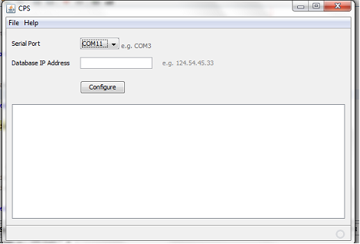
Serial Client
Port Detection
Database Integration

Slide 13
Serial Client
Challenges
Xbee delivers the data in byte chunks
Identify the individual values and make a meaningful data

Slide 14
Graph Visualization
Temperature and Humidity Graphs
Options:
Complete Visualization
Latest data only

Slide 15
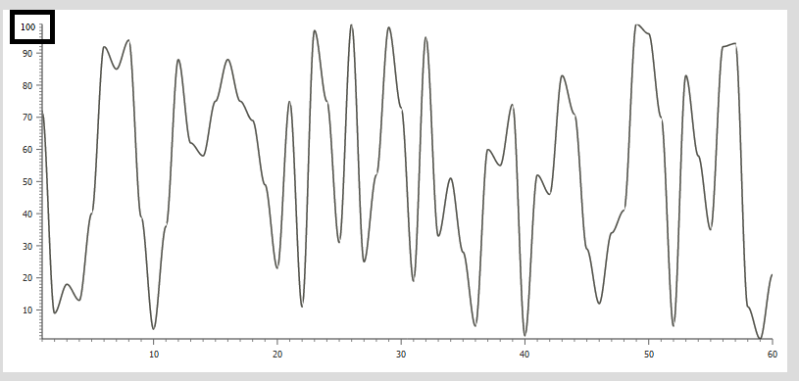
Graph Visualization
Temperature
Upto 100 units
Temperature Graph

Slide 16
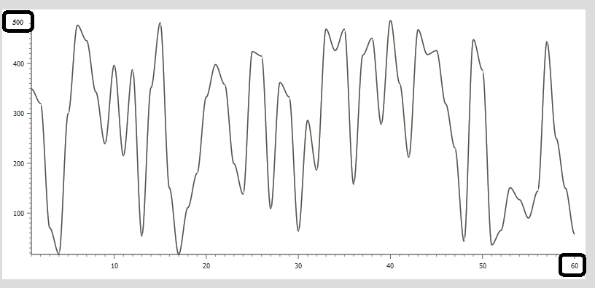
Graph Visualization
Humidity
Max 500
Last minute data
Humidity Graph

Slide 17
Database Team
Arun Chacko
Hsu Wan Kao (Peter)

Slide 18
Database Tasks
Design the database based on the requirements.
Create the database schema.
Implement the database schema (SQL).
Create the database interaction class, so the GUI team can interface with the database.

Slide 19
Database Design
Database used: MySql
3 Tables:
Station
Readings
UserDetails
Database interaction class:
Written in JAVA
10 Functions

Slide 20
Database Schema
Station
User Details
Readings

Slide 21
Database Implementation
drop database if exists cps;
create database cps;
use cps;
--
-- Table structure for table `station`
--
DROP TABLE IF EXISTS `station`;
CREATE TABLE `station` (
`panid` varchar(100) NOT NULL,
`myid` varchar(200) NOT NULL,
`userid` varchar(50) DEFAULT NULL,
PRIMARY KEY (`myid`)
) ENGINE=MyISAM DEFAULT CHARSET=latin1;
--
-- Table structure for table `readings`
--
DROP TABLE IF EXISTS `readings`;
CREATE TABLE `readings` (
`auto` int(11) NOT NULL AUTO_INCREMENT,
`timestamp` datetime NOT NULL,
`panid` varchar(100) NOT NULL,
`myid` varchar(200) NOT NULL,
`temp` double NOT NULL,
`moist` double NOT NULL,
PRIMARY KEY (`auto`),
KEY `myid` (`myid`),
FOREIGN KEY (myid) REFERENCES station(myid)
) ENGINE=MyISAM AUTO_INCREMENT=10 DEFAULT CHARSET=latin1;
--
-- Table structure for table `readings`
--
DROP TABLE IF EXISTS `readings`;
CREATE TABLE `readings` (
`auto` int(11) NOT NULL AUTO_INCREMENT,
`timestamp` datetime NOT NULL,
`panid` varchar(100) NOT NULL,
`myid` varchar(200) NOT NULL,
`temp` double NOT NULL,
`moist` double NOT NULL,
PRIMARY KEY (`auto`),
KEY `myid` (`myid`),
FOREIGN KEY (myid) REFERENCES station(myid)
) ENGINE=MyISAM AUTO_INCREMENT=10 DEFAULT CHARSET=latin1;
--
-- Table structure for table `userdetails`
--
DROP TABLE IF EXISTS `userdetails`;
CREATE TABLE `userdetails` (
`userid` varchar(50) NOT NULL,
`password` varchar(20) DEFAULT NULL,
`firstname` varchar(20) DEFAULT NULL,
`middlename` varchar(20) DEFAULT NULL,
`lastname` varchar(20) DEFAULT NULL,
`contact` varchar(15) DEFAULT NULL,
`address` varchar(50) DEFAULT NULL,
`city` varchar(20) DEFAULT NULL,
`state` varchar(20) DEFAULT NULL,
`email` varchar(100) DEFAULT NULL,
`securityquestion` varchar(100) DEFAULT NULL,
`securityanswer` varchar(100) DEFAULT NULL,
PRIMARY KEY (`userid`)
) ENGINE=InnoDB DEFAULT CHARSET=latin1;

Slide 22
Database Interaction Class
Class that allows the GUI team to interface with the database.
Functions:
+Database: constructor
-getDateTime: get current date and time
+openDatabase: connects to database
+closeDatabase: disconnects database
+insertData: stores panID, myID, temperature, and moisture into database
+fetchData: fetches a result set of a sensor's periodical values values
+fData: returns a string array. Timestamps and values are alternately stored in the array
+addStation: adds a new station into database
+removeStation: removes a station from database
+dummyData: generates dummy data with given sampling period and lasting time

Slide 23
AURDINO GUI
By
U L Deepak
Gowthami Muddana

Slide 24
Part of the project we have worked on:
GUI:
Register
Login
Add Station
Remove Station

Slide 25
AURDINO GUI
It consists of the following modules
Monitor
Add station
Remove station

Slide 26
Serial Port Reader
Arun Chacko
Hsu Wan Kao (Peter)

Slide 27
Java Communication
Sun's JavaSoft division provides support for RS-232 and parallel devices with standard extensions
The Java Communications (a.k.a. javax.comm) API is a proposed standard extension that enables authors of communications applications to write Java software that accesses communications ports in a platform-independent way.

Slide 28
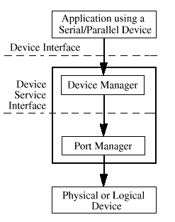
Javax
how to use javax.comm to communicate with a serial device based on RS-232
This API may be used to write terminal emulation software, fax software, smart-card reader software, and so on.

Slide 29
Demo

